Slide 1

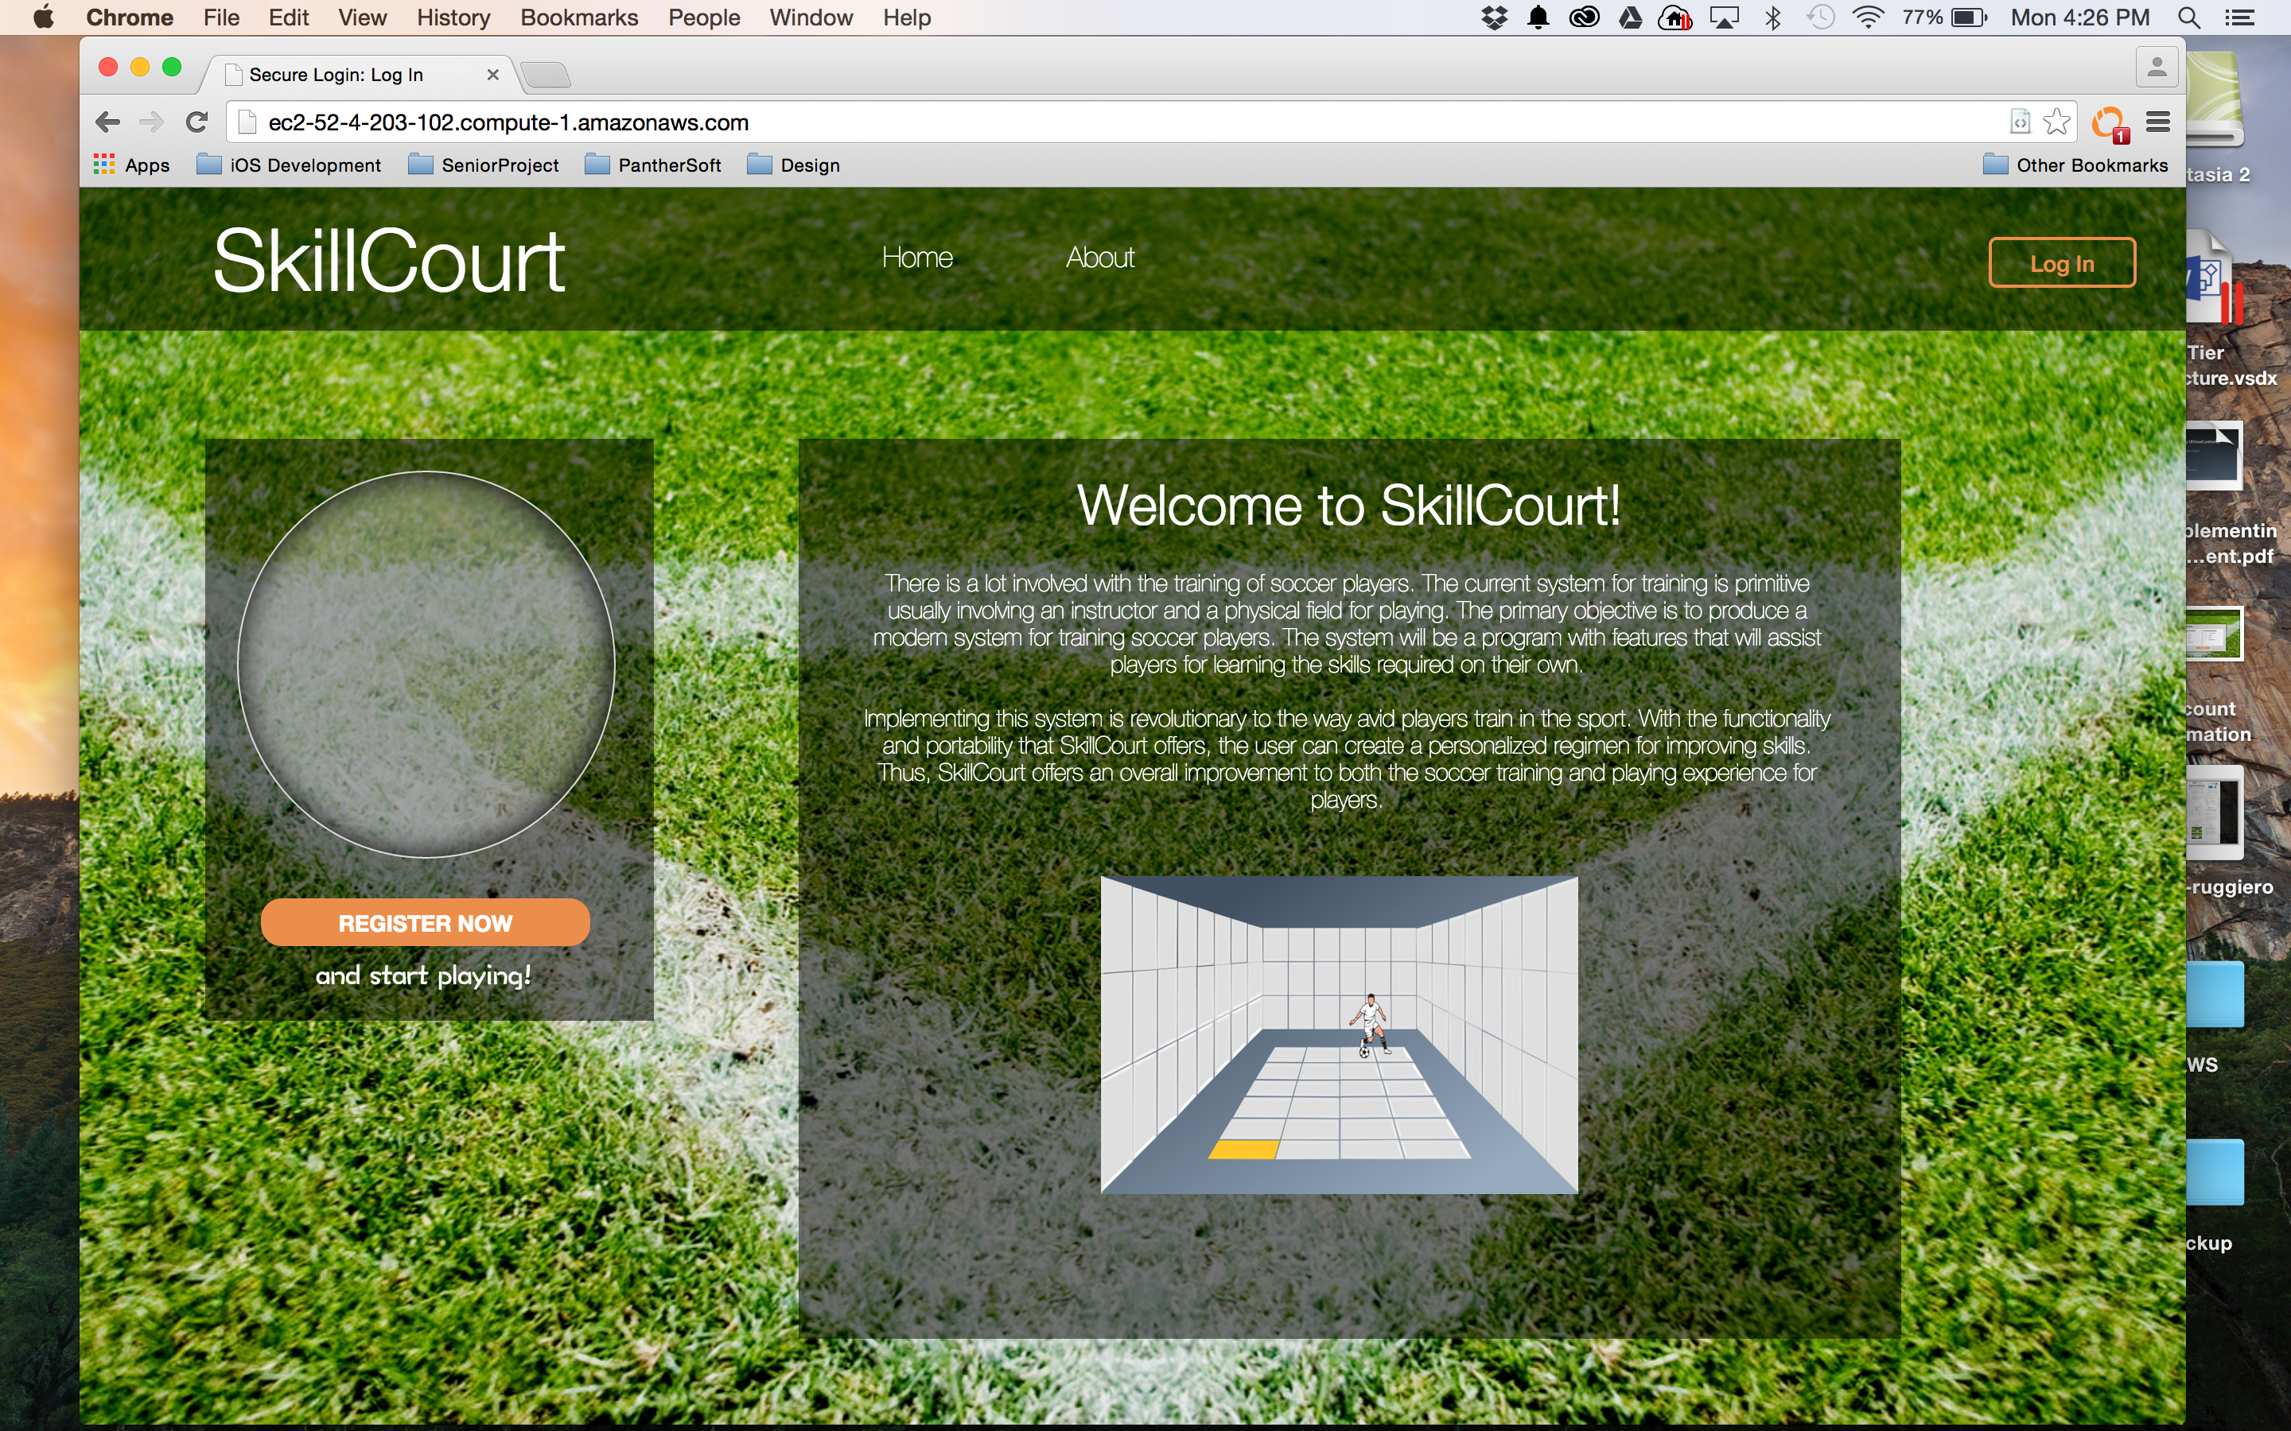
SkillCourt v2
Mentors:
Team Members:
Gummi Traustason & Jaime Borras
Erico Oyarzun & Andres Ruggiero

Slide 2
Problem
Skillcourt
Team focused sport.
One coach per team.
Lack of individual supervision.
Infrastructure requirements.
Notes:
PROBLEM
Soccer is a team-focused sport that has only one coach dedicated to the entire team, and the problem arises when players want to train & improve individual weaknesses. Moreover, the infrastructure requirements are very expensive because of the need for a physical field.
SkillCourt allows players to have a one-to-one interaction with the system, providing the ability to perform different routines to customize the player’s training experience. The concept constitutes of a SkillCourt room filled with sensor pads. The pads would also illuminate with different colors, and are used to provide guidance to the player on how to move or what targets to hit.

Slide 3
Current system
Skillcourt
Limitations
Requires
Arduino Micro-controller
Mobile Application
Desktop Simulator
Notes:
The current system is an Android Application that connects via Bluetooth and an Arduino Microcontroller, to a desktop simulation of the SkillCourt room.
The current system’s major limitation is that it requires the combination of an Arduino Micro-controller, a mobile application and the desktop simulator. This significantly reduces the audience that has access to the system, therefore affecting the project overall.

Slide 4
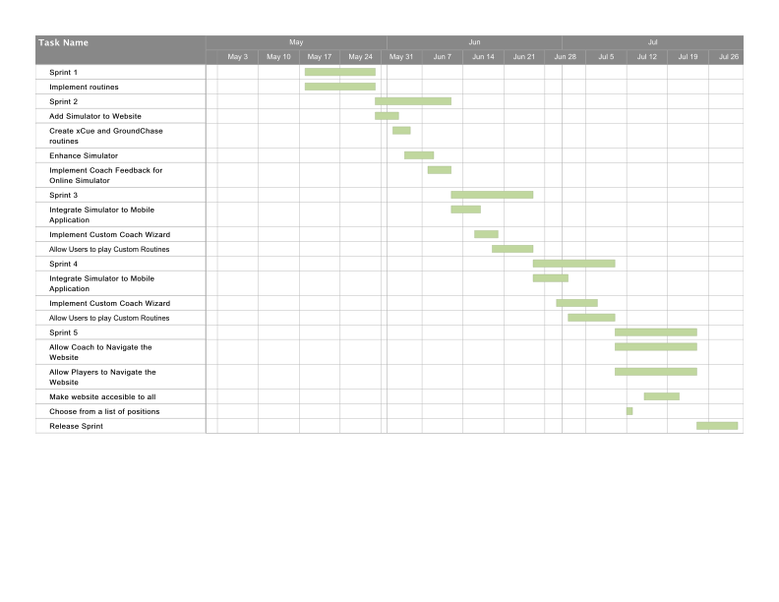
Schedule
Skillcourt
Notes:
Agile Scrum was used as a development methodology.
Our schedule shows how the project was divided into 5 two-week development sprints.
Each sprint consisted of Planning, the daily scrum meetings, and were wrapped up by a sprint review and retrospective meeting.

Slide 5
Implemented User Stories
Skillcourt
Add Simulator to Website
Enhance Web Simulator
Integrate Simulator to Mobile Application
Create Custom Coach Routine Wizard
Allow a Coach User to Navigate the Website
Make Website Accessible to All
Notes:
The User Stories I implemented are the following:
Adding simulator to website
Enhancing web Simulator
Integrating Simulator to Mobile Application
Creating Custom Coach Routine Wizard
Allowing a Coach User to Navigate the Website
& Making the Website Accessible to All

Slide 6
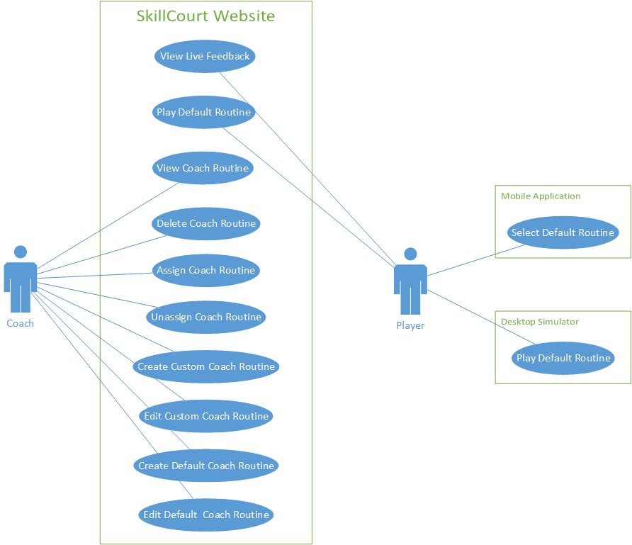
Use Case Diagram
Skillcourt
Notes:
This is the Use Case Diagram for my use cases.
As you can see, there is a much greater focus on building features for the website over the Desktop Simulator and Mobile App
My development allowed for
Player Users to be able to select and play our Default Routines through the mobile application, and select and play Default routines on the web simulator while viewing their live feedback
It also allowed for Coach users to be able to
Create,View, delete, Assign, and unassign coach routines

Slide 7
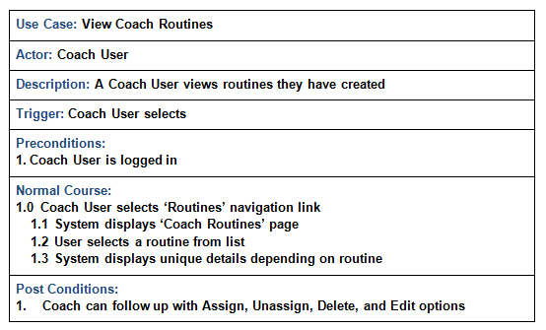
Use Case
Skillcourt
Notes:
The following use case is View Coach Routines for a Coach User actor.
After selecting the ‘Routines’ navigation link, the User is taken to a list of their created routines.
The user will then select a routine from the list and will be shown the corresponding description and list of the players who the routine is currently assigned to

Slide 8
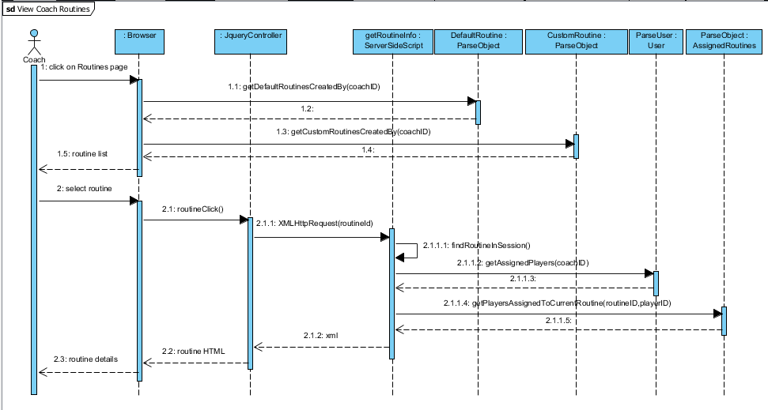
Sequence diagram
Skillcourt
Notes:
This is the sequence diagram for the View Coach Routine use case.
As you can see the player initially enters the page at which point the routines belonging to the coach are retrieved and shown
Once the user selects a routine, an ajax request is made to gather that routine’s information and display it

Slide 9
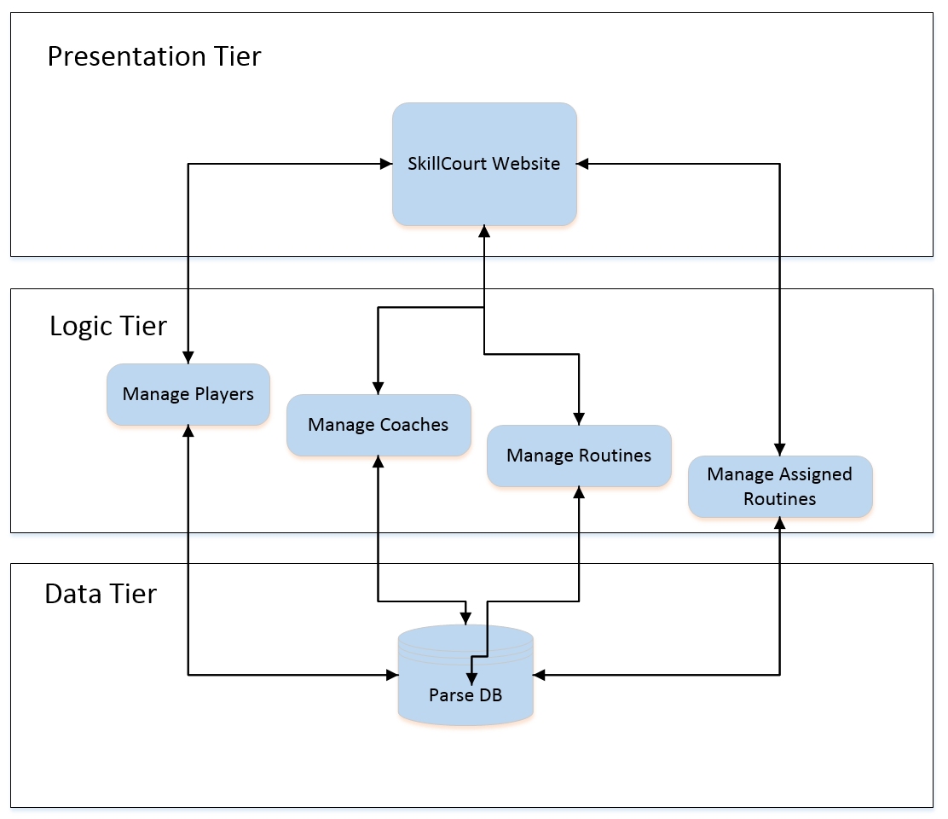
System Design
Skillcourt
3 - Tier Architecture
Notes:
The system design patterns used in the project are the 3 tier Architecture, and MVC.
The three tier architecture is to provide independency between the User Interface, the logic processing and the data model.
And the Model View Controller pattern was adopted from the previous system
and is used to develop the subsystem that includes the Mobile Application, Arduino Microcontroller, and Desktop Simulator.

Slide 10
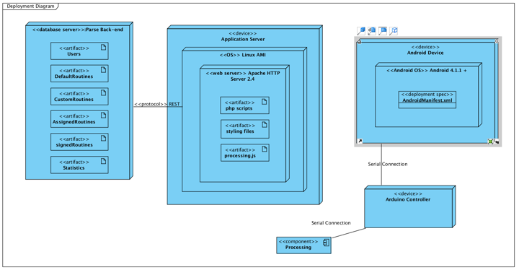
System deployment
Skillcourt
Notes:
SYSTEM DEPLOYMENT
The hardware requirements included an android device with bluetooth capabilities , as well as an arduino micro-controller.
As for software requirements, we used
Processing, which is Java based, to refactor the desktop simulator
Processingjs to develop the online version of the simulator.
PHP, Javascript, jQuery, HTML5 and CSS to develop the website.
Android Studio to enhance the mobile application
Parse API to communicate with the backend
Amazon Web Services was used to host the website.

Slide 11
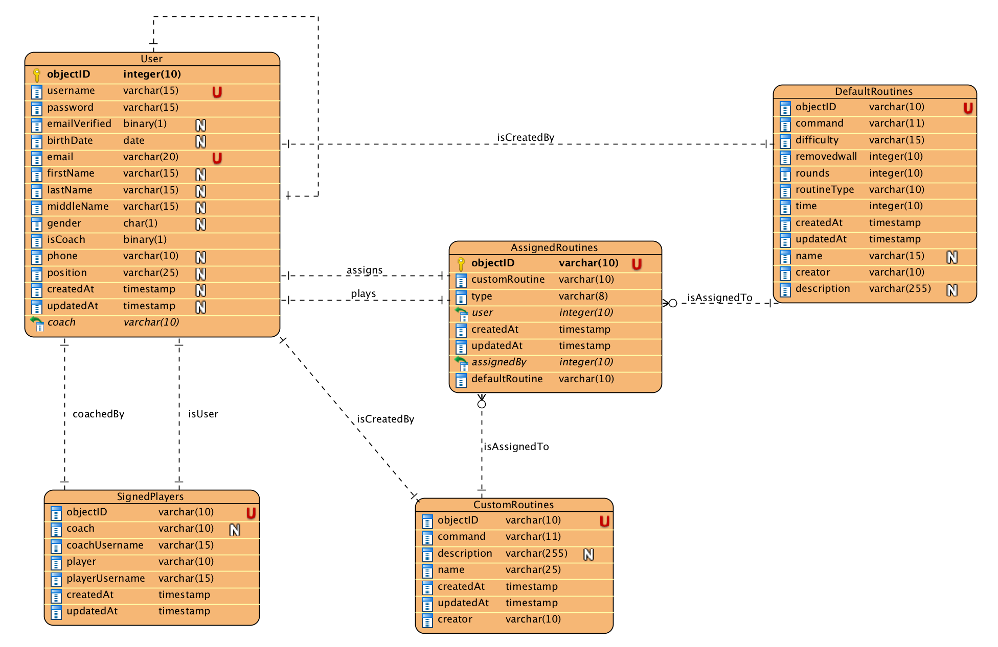
Persistent Data Design
Skillcourt
Notes:
PERSISTENT DATA DESIGN
This is the diagram that shows what our database is composed of.
It shows we have users, that can be either coaches or players
We store default and custom routines separately
We keep track of which players are signed to which coach
And which routines have been assigned to which players

Slide 12

Security and Privacy
Skillcourt
Encryption protocols over
sensitive data
Session Management
Notes:
SECURITY AND PRIVACY
We chose to migrate to Parse because it provides services such as data encryption and session management.
This implies that sensitive information is being securely encrypted and transmitted throughout the network,
and session management helps prevents users from viewing undesired information.

Slide 13
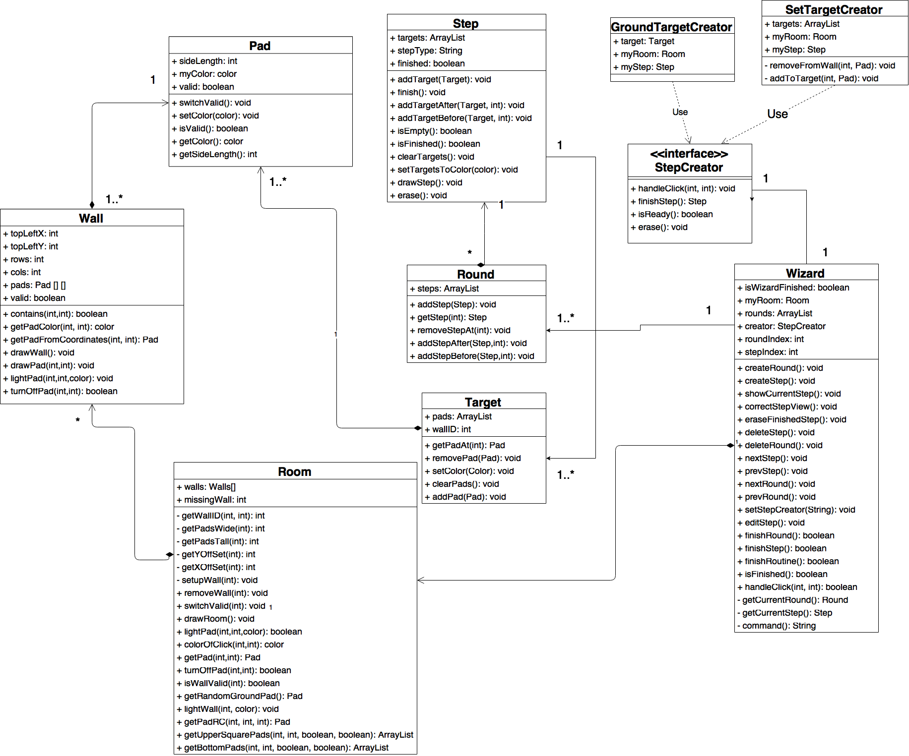
Class Diagram
Skillcourt
Notes:
This is the Class diagram for the Routine Wizard on the website.
The Routine Wizard is used by a coach to create a custom routine step by step and round by round.
The Wizard is currently able to make both simple ground steps and wall target steps.
This was performed by implementing a StepCreatorInterface.
Which leaves the Routine Wizard open to enhancement through the addition of new step types that would simply need to implement this interface,

Slide 14
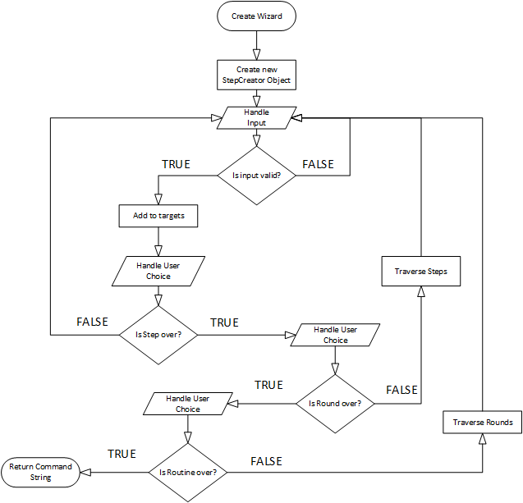
Main Algorithm
Skillcourt
Notes:
The main algorithm of the wizard deals with responding to user choices.
A user can create steps and add those steps to as
many rounds as they would like until they decide to finish the routine

Slide 15
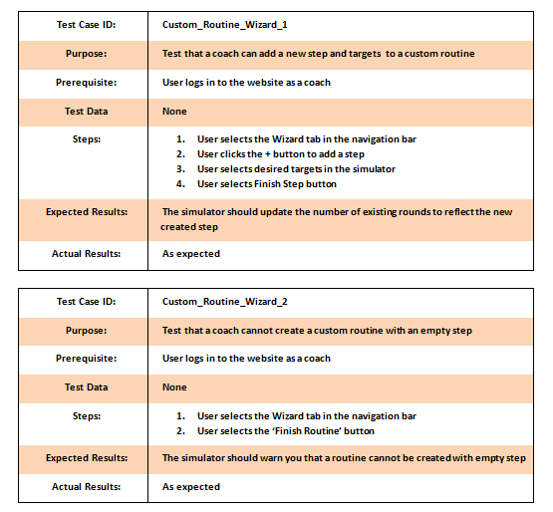
Test Cases
Skillcourt
Sunny Day
Rainy Day
Notes:
TEST CASES
After Implementing the wizard, one of the most important components to test was the Create Custom Routine use case.
First we must ensure that a player could add a step to the custom routine.
We tested to see if a user could increment the number of total steps in a round, select a proper target, and finish the step.
The results were as expected, the step was finished properly.
Another important test case was to make sure that a routine with unfinished steps wouldn’t be able to be finished .
We opened the routine wizard and immediately clicked on ‘Finish Custom Routine’
The results are as expected; the system blocks the creation of the routine

Slide 16
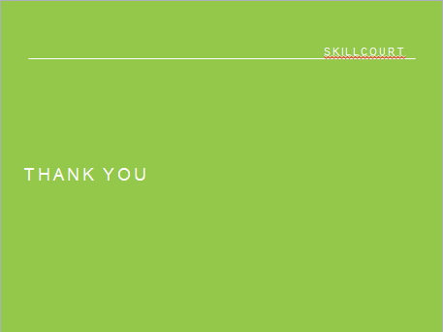
Notes:
That concludes my presentation
Thank you everyone for your time

